Slide 1

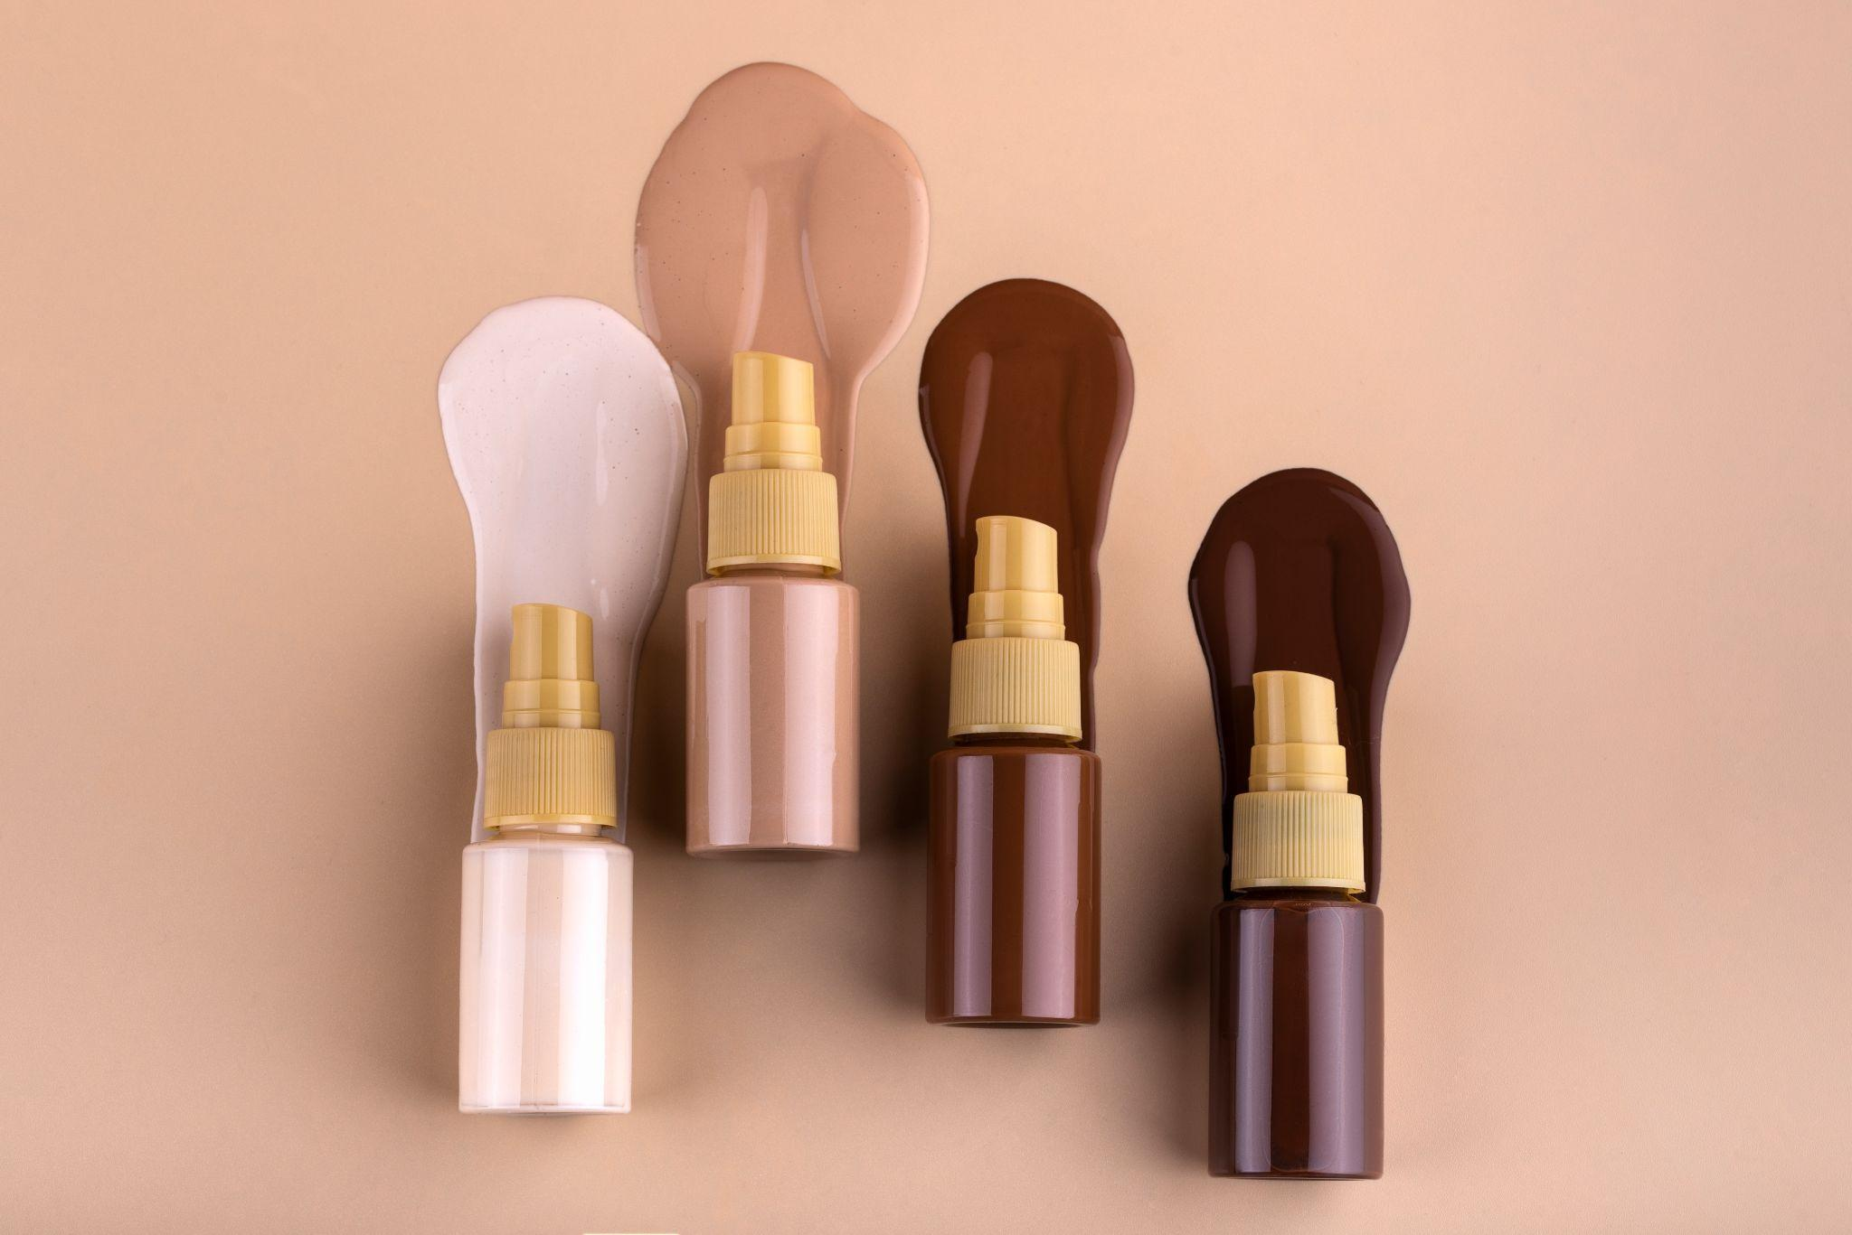
Nykaa Analysis

Slide 2

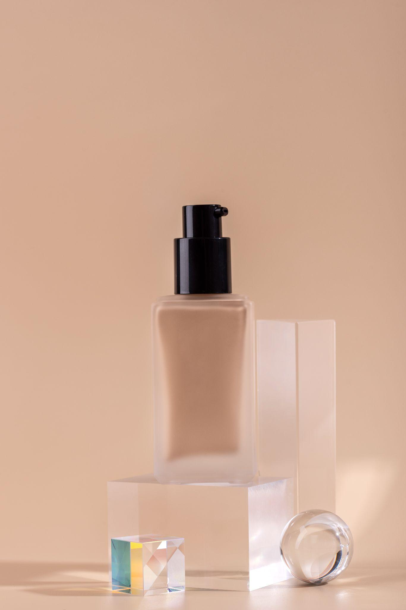
01
Introduction

Slide 3

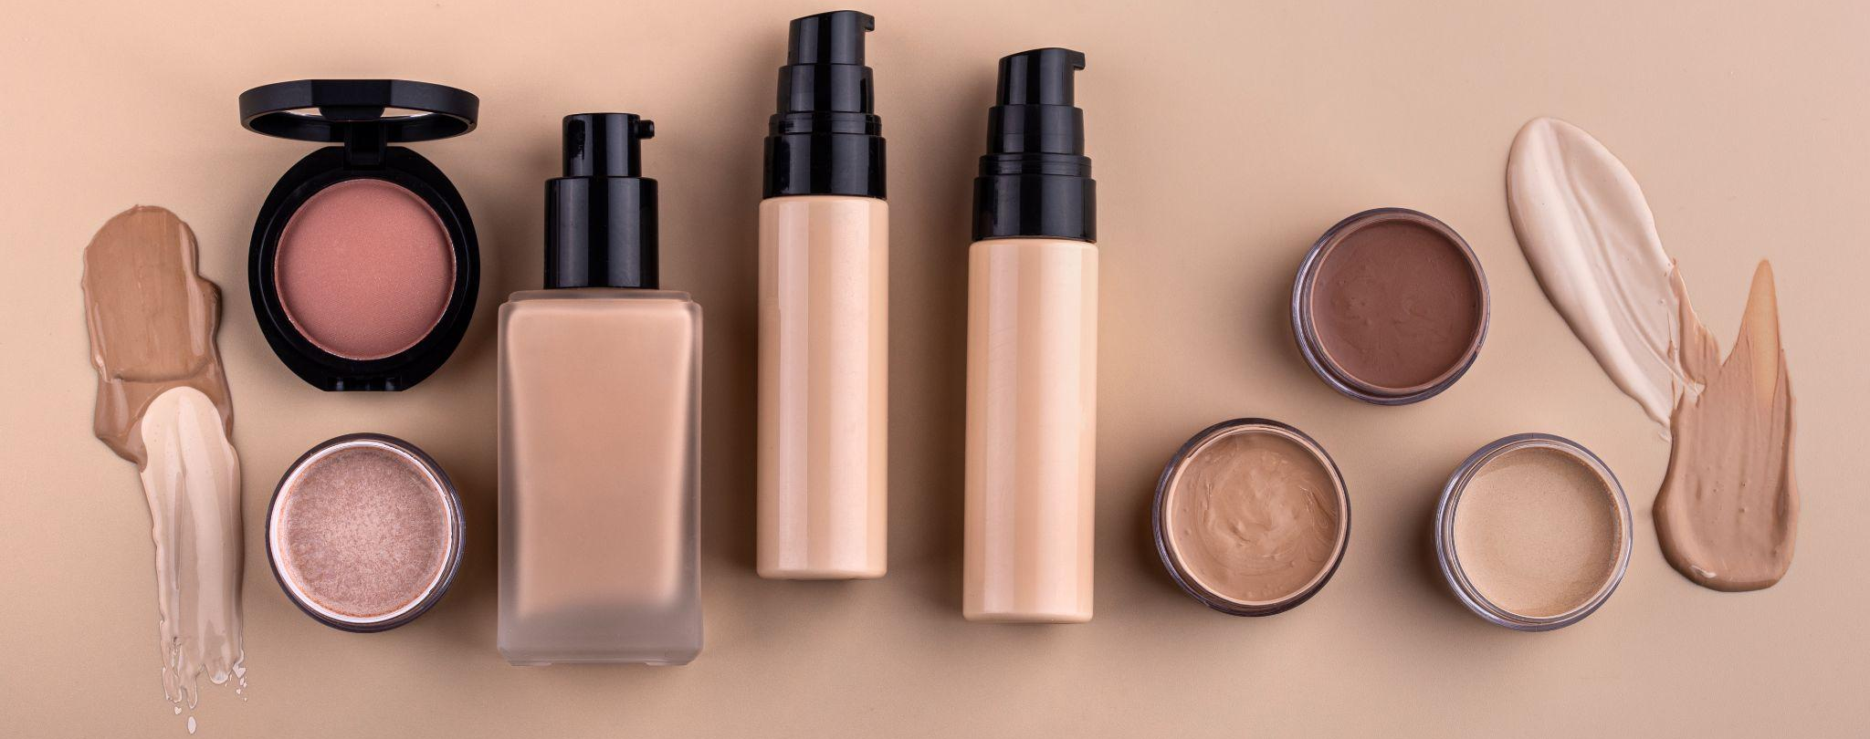
Introduction
Our company
Nykaa, founded in 2012 by Falguni Nayar, is a leading Indian beauty and lifestyle retail company with an omnichannel presence through its website, app, and physical stores.
The company offers over 2,000 brands and 200,000 products, focusing on beauty, wellness, and fashion.

Slide 4
Objectives of the Project
Key Goals:
Analyze Nykaa’s business operations and revenue sources Evaluate customer trends and engagement strategies Study data-driven approaches for market positioning

Slide 5
Business Model:
Inventory-Based Model: Nykaa procures products directly from manufacturers, ensuring authenticity and quality through its warehouses in Mumbai, Delhi, and Bangalore.
Omnichannel Strategy: It operates through online platforms and over 100 physical stores across India, enhancing customer reach.
Diverse Product Range: Nykaa caters to a wide audience with categories spanning beauty, fashion, wellness, and luxury brands.
Inventory-Based Model: Nykaa procures products directly from manufacturers, ensuring authenticity and quality through its warehouses in Mumbai, Delhi, and Bangalore.
Omnichannel Strategy: It operates through online platforms and over 100 physical stores across India, enhancing customer reach.
Diverse Product Range: Nykaa caters to a wide audience with categories spanning beauty, fashion, wellness, and luxury brands.
Inventory-Based Model: Nykaa procures products directly from manufacturers, ensuring authenticity and quality through its warehouses in Mumbai, Delhi, and Bangalore.
Omnichannel Strategy: It operates through online platforms and over 100 physical stores across India, enhancing customer reach.
Diverse Product Range: Nykaa caters to a wide audience with categories spanning beauty, fashion, wellness, and luxury brands.

Slide 6

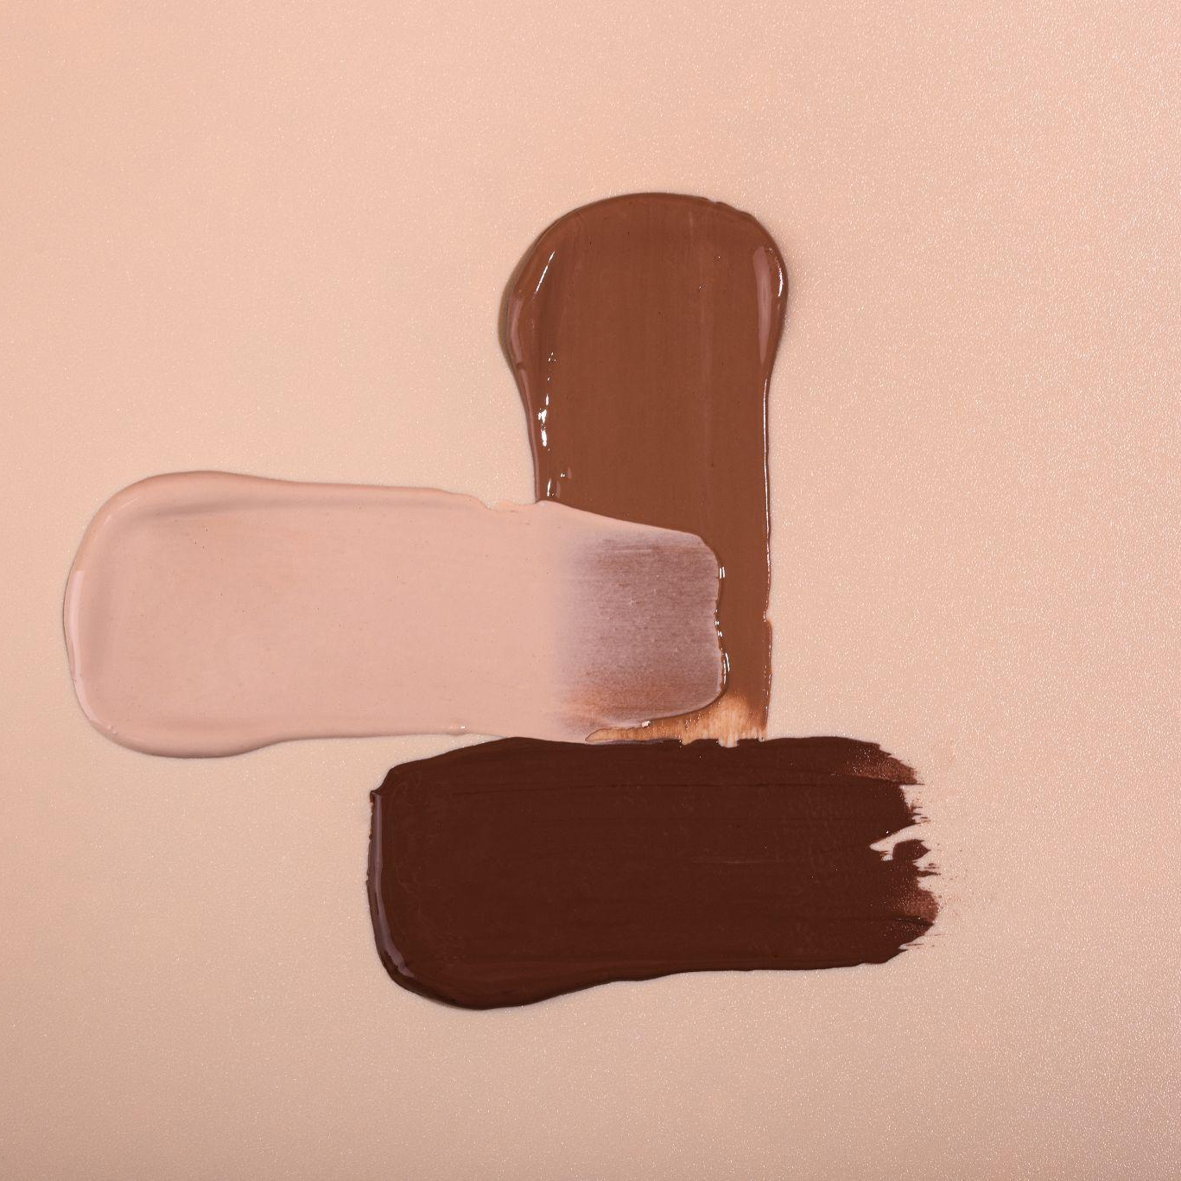
Revenue and profit
In FY 2022-23, Nykaa's revenue increased 36% to ₹5,143.8 crore
In the third quarter of 2024, Nykaa's revenue increased 27% year-on-year to ₹2,267 crore
In the third quarter of 2024, Nykaa's net profit increased 61% year-on-year to ₹26.12 crore
In FY 2022-23, Nykaa's revenue increased 36% to ₹5,143.8 crore
In the third quarter of 2024, Nykaa's revenue increased 27% year-on-year to ₹2,267 crore
In the third quarter of 2024, Nykaa's net profit increased 61% year-on-year to ₹26.12 crore
In FY 2022-23, Nykaa's revenue increased 36% to ₹5,143.8 crore
In the third quarter of 2024, Nykaa's revenue increased 27% year-on-year to ₹2,267 crore
In the third quarter of 2024, Nykaa's net profit increased 61% year-on-year to ₹26.12 crore

Slide 7
Growth plans
Nykaa plans to expand to 350 stores in two years
Nykaa plans to expand internationally in the GCC market with 70 stores over 4-5 years

Slide 8
Market Position & Growth
Strong brand trust and customer loyalty.
First profitable unicorn in India’s beauty sector (2020).
Exclusive partnerships with premium global brands.

Slide 9
Customer Preferences & Market Trends
Popular Categories:
Preferred Payment Methods:
Skincare → 40%
Makeup → 30%
Haircare → 20%
Wellness & Fragrances → 10%
UPI & Wallets → 60%
Cards → 30%
COD → 10%

Slide 10
Market Trends & Opportunities
Growth in men’s grooming & wellness
Demand for organic & sustainable beauty
Increased spending on luxury brands
Rise in AI-driven personalized shopping

Slide 11
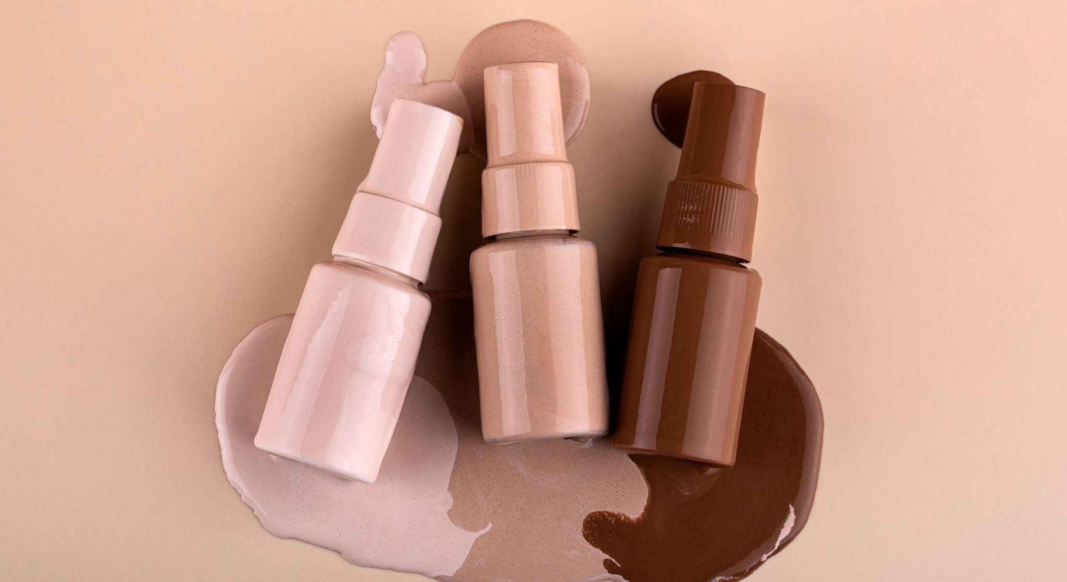
10,830,000
Number of users analyzed in our market research

Slide 12
Future Outlook
Projected Market:
India’s beauty & personal care market to hit $30 billion by 2027
Expansion Plans:
New categories (Fashion, Home, Wellness)
Offline expansion
AI/ML-driven personalization

Slide 13
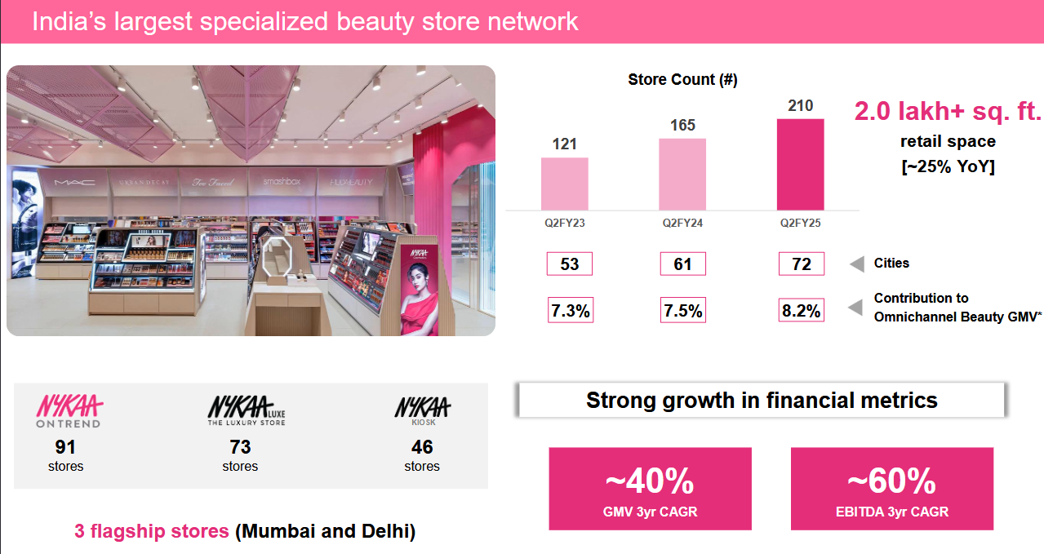
Nykaa’s Retail Footprint

Slide 14
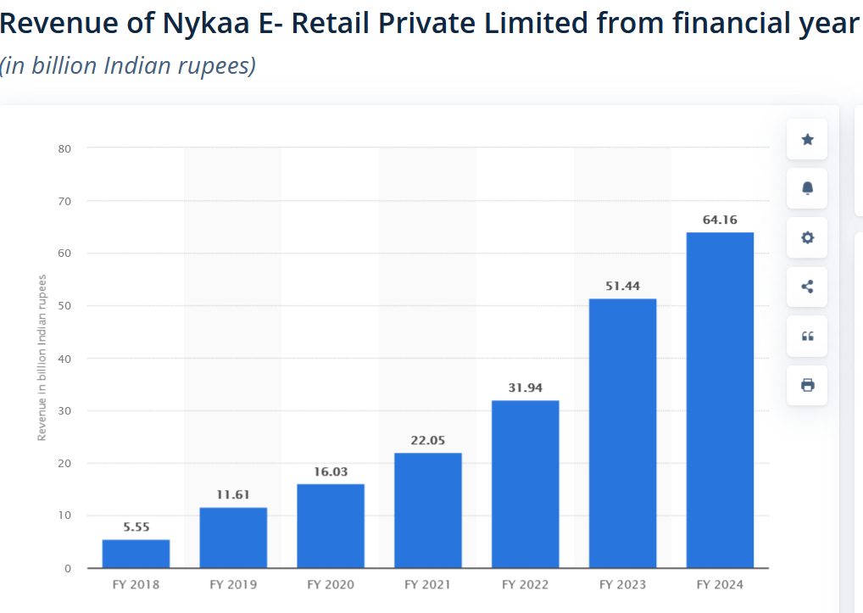
Nykaa’s Financial Performance: Yearly Revenue Insights

Slide 15
Strategic Recommendations for Nykaa
Strengthen Omnichannel Presence
Improve Logistics & Delivery Speed
Expand offline stores in Tier 2 & 3 cities for better accessibility.
Improve the integration between online & offline shopping experiences.
Partner with local delivery services to reduce shipping time.
Establish regional warehouses for faster order fulfillment.
Expand Fashion Category
Competitive Pricing & Discounts
Increase investment in Nykaa Fashion to compete with Myntra
introduce more budget-friendly beauty products to compete with Amazon & Purplle.
Offer exclusive discounts & bundles for loyalty program members.
Collaborate with popular fashion influencers & designers.

Slide 16
SWOT ANALYSIS
SWOT ANALYSIS

Slide 17
Strengths
Strong Brand Presence Nykaa is a well-established brand in the Indian beauty and personal care industry, known for its wide range of authentic products. Omnichannel Business Model It operates both online and offline, with a strong e-commerce platform and physical stores. Strong Digital Marketing & Influencer Collaborations Leverages social media influencers, celebrities, and content marketing effectively. Customer Trust & Authenticity Ensures genuine products, which builds customer loyalty in a market where counterfeit products are a concern.

Slide 18
Weaknesses
High Operational Costs Running physical stores and managing logistics increases costs. Dependence on Third-Party Brands While Nykaa has its private label, it still heavily relies on third-party brands for revenue. Limited International Expansion Nykaa primarily operates in India and has yet to expand significantly into global markets. Competitive Pricing Pressure Faces stiff competition from players like Amazon, Flipkart, and other beauty platforms, which sometimes leads to aggressive discounting.

Slide 19
Opportunities
Growth in Indian Beauty & Wellness Industry The beauty and personal care market in India is expanding rapidly, providing a huge opportunity for Nykaa. Expansion into Tier 2 & Tier 3 Cities Increasing demand for branded beauty and fashion products in smaller cities presents a great growth avenue. Global Expansion Entering international markets can further enhance brand visibility and revenue. Technology & AI Integration Enhancing personalization and customer experience using AI-driven recommendations and virtual try-ons.

Slide 20
Threats
Intense Competition Faces competition from global giants like Sephora, as well as local e-commerce platforms. Regulatory & Compliance Risks Changes in government regulations regarding e-commerce, taxation, and product safety can impact operations. Economic Slowdowns A decline in consumer spending due to economic factors can affect sales. Counterfeit Product Risks Despite efforts to ensure authenticity, the rise of fake products in the beauty industry can affect brand trust.

Slide 21
COMPETITIVE ANALYSIS

Slide 22
Factor | Nykaa | Amazon | Flipkart | Myntra | Purplle
Core Focus | Beauty & Fashion | Multi-category | Multi-category | Fashion & Beauty | Beauty & Personal Care
Target Audience | Beauty-conscious users | Mass-market | Budget-conscious users | Fashion lovers | Budget & mid-range beauty shoppers
Product Variety | High (Luxury & Drugstore) | Wide range | Moderate | High in fashion, moderate in beauty | Moderate (Mostly budget-friendly)
Omnichannel Presence | Online + 150+ offline stores | Online | Online | Online + Few offline stores | Online
Pricing Strategy | Premium & mid-range | Competitive | Discount-heavy | Mid-range & premium | Affordable & discounts
Brand Partnerships | Exclusive global & luxury brands | Popular mass brands | Popular Indian & global brands | Exclusive fashion collaborations | Affordable & Indian brands
Loyalty Program | Nykaa Privé | Prime | Supercoins | Insider | Purplle Elite

Slide 23
CUSTOMER ANALYSIS

Slide 24
Nykaa Customer Demographics & Behavior
18-24 years → 35%
25-34 years → 45%
35-44 years → 15%
45+ years → 5%
Female → 80%
Male → 20%
Customer Demographics
Location
Age Group:
18-24 years → 35%
25-34 years → 45%
35-44 years → 15%
45+ years → 5%
Metro Cities → 55%
Tier 2 & 3 Cities → 45%
Gender:
Female → 80%
Male → 20% → 80%
Male → 20%

Slide 25
Customer Behavior
Monthly shoppers → 30%
Every 3-6 months → 50%
Seasonal shoppers → 20%
Female → 80%
Male → 20%
Shopping Frequency:
Key Purchase Drivers:
Monthly shoppers → 30%
Every 3-6 months → 50%
Seasonal shoppers → 20%
Discounts & Offers
Brand Loyalty
Influencer Recommendations
Product Reviews

Slide 26
Customer Reviews & Feedback
Nykaa’s Impact on Customers ✔️ Trusted beauty & wellness platform in India ✔️ Known for authentic & wide product range

Slide 27
Positive Reviews ⭐⭐⭐⭐⭐
Product Authenticity:
"100% genuine products, no
duplicates!“
User-Friendly App & Website:
"Smooth interface, easy checkout, &
quick filters!“
Fast Delivery & Packaging:
"Well-packed products & super fast
delivery!"
Exclusive Discounts & Offers:
"Best deals on premium brands,
great savings!“
Customer Support:
"Helpful support team, easy
returns & refunds!"

Slide 28
Negative Reviews & Concerns ⚠️
❌ Delayed Deliveries in Some Areas
"Delivery took longer than expected!"
❌ Pricing & Discounts
"Some products are priced higher than retail stores."
Return Policy Limitations
"Not all products are returnable, needs improvement."
❌ Stock Availability Issues
"Popular products go out of stock too soon!"

Slide 29
Overall Customer Sentiment 😊
90%+ customers rate Nykaa 4+ stars 🌟
High trust for beauty products in India.
Continuous improvements in delivery & returns.

Slide 30


Slide 31
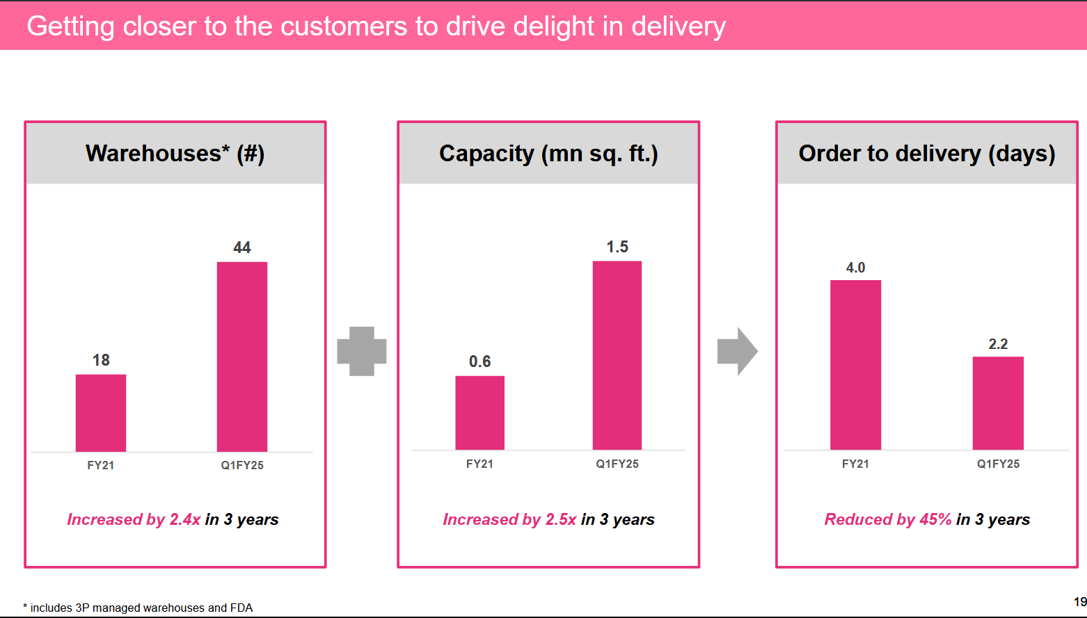

Slide 32
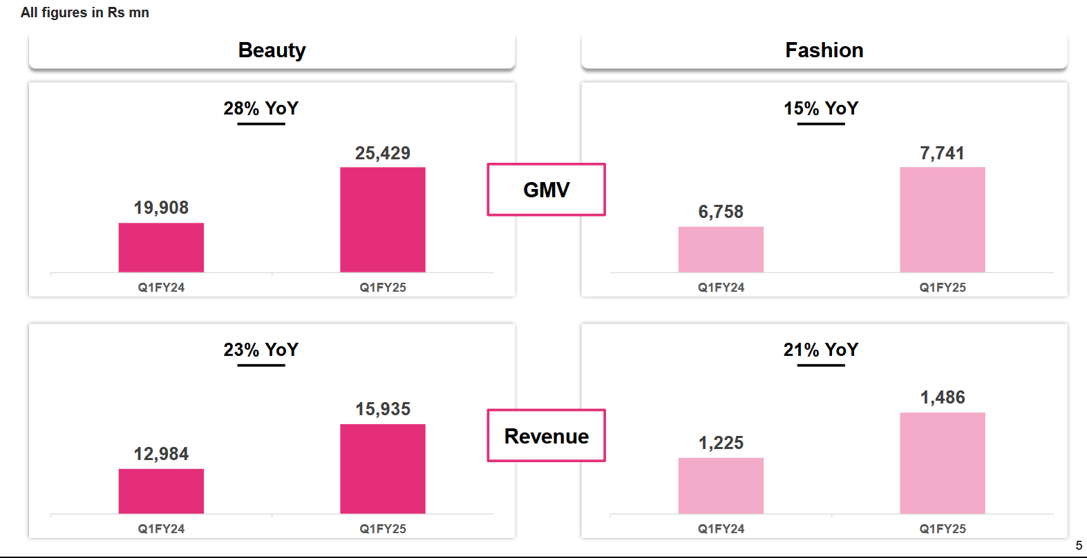

Slide 33
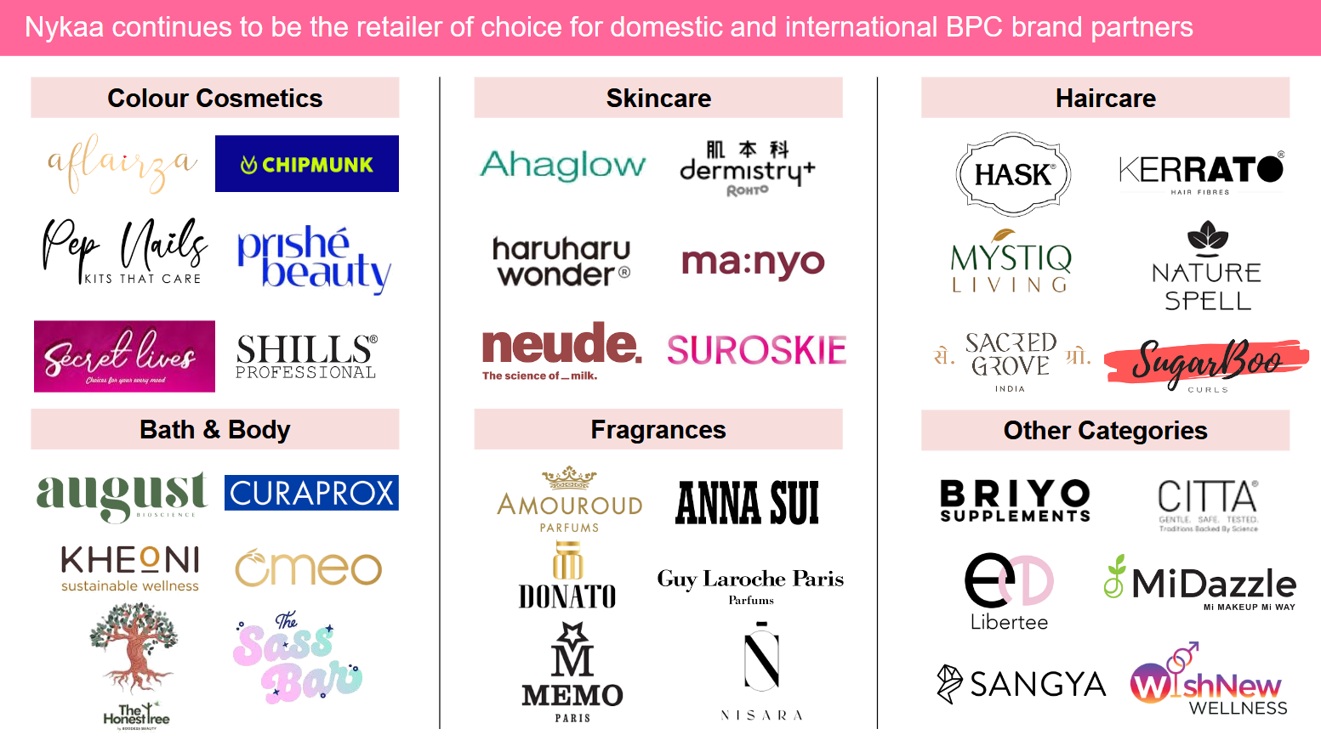

Slide 34
Conclusion
Nykaa has revolutionized beauty & fashion e-commerce in India
Strong brand presence & innovative digital marketing
Future-focused on sustainability, tech, and global expansion
Positioned for long-term growth despite competitive challenges

Slide 35
Thankyou 😊

